Slide 1


Guide to use TestLink
For Admin Role

Slide 2
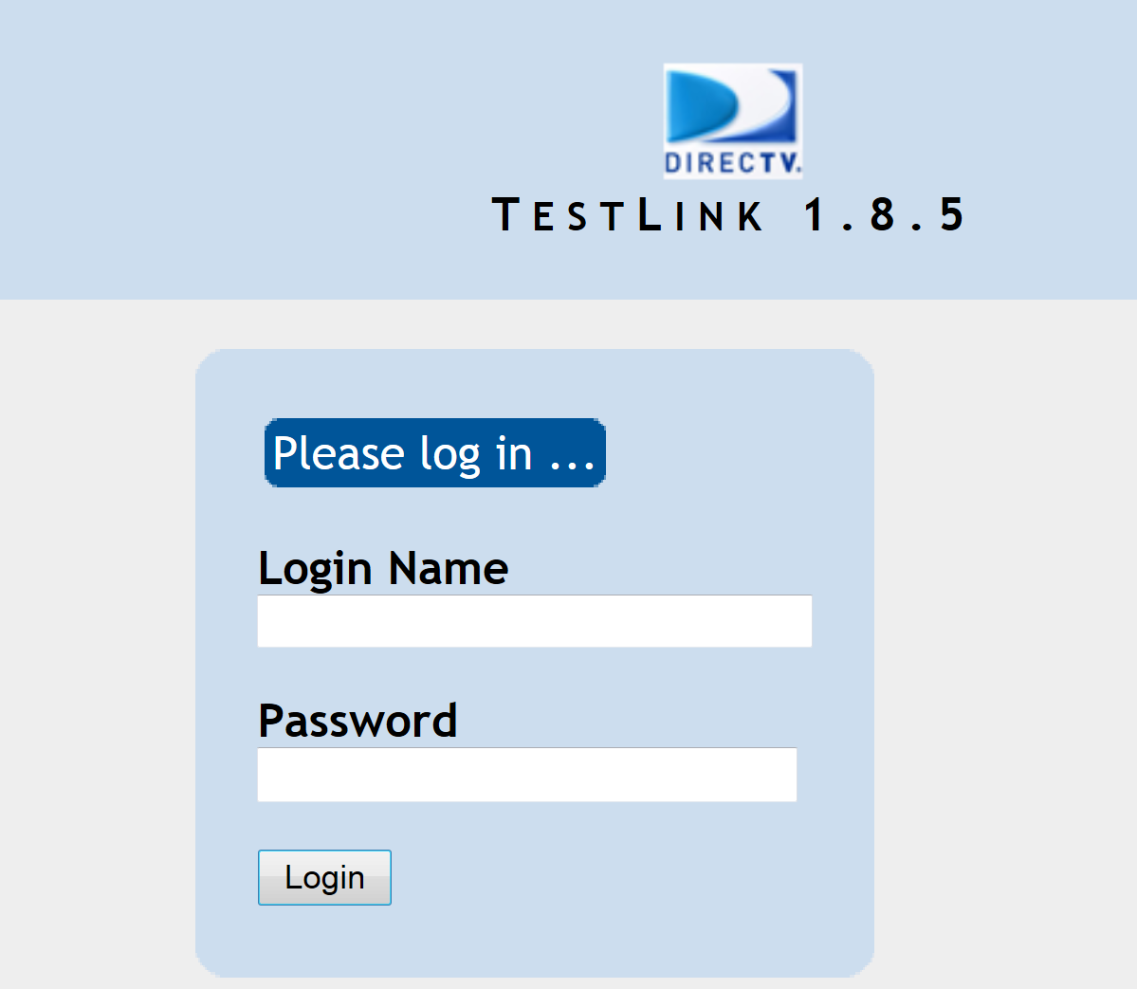
Overview
This course will guide through normal workflow of an Admin role when working with TestLink.

Slide 3
What Administrators need to know?
How to manage user account (add/remove users, assign role to users on Test Project or Test Plan)
How to manage test project, test plan, compare test plan, test cases.
How to view history of test creation an individual test case.

Slide 4
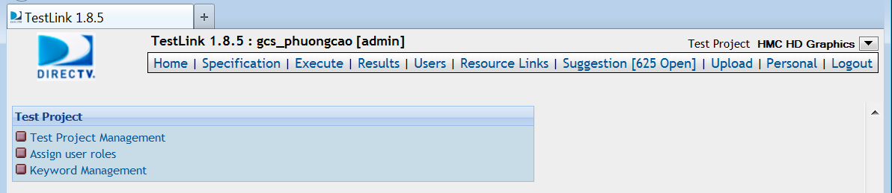
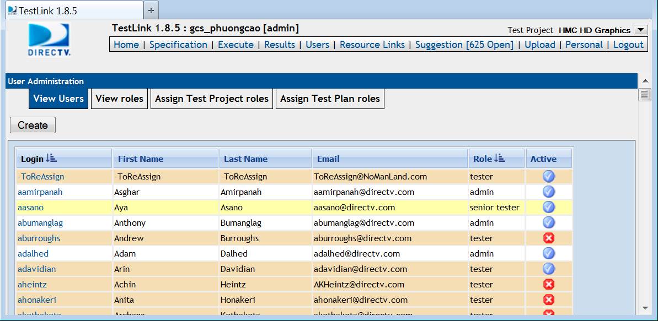
Manage user account
To manage user account, you must select “Assign user roles” link or “Users” on the menu. They both links to the "User Administration" page.

Slide 5
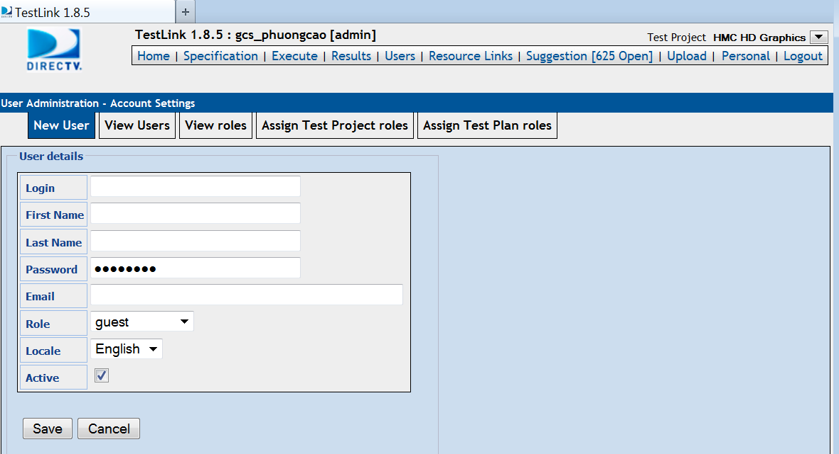


Manage user account – Add user
To create new user, select “View Users” tab, and click on “Create” button.
You must fill in the user details:
Login: name used to login TestLink
First name and Last Name
Password used to login
Email of the user
Role of user : tester/lead/senior tester/admin/guest.
Locale: usually English
Active checkbox is checked as default.

Slide 6
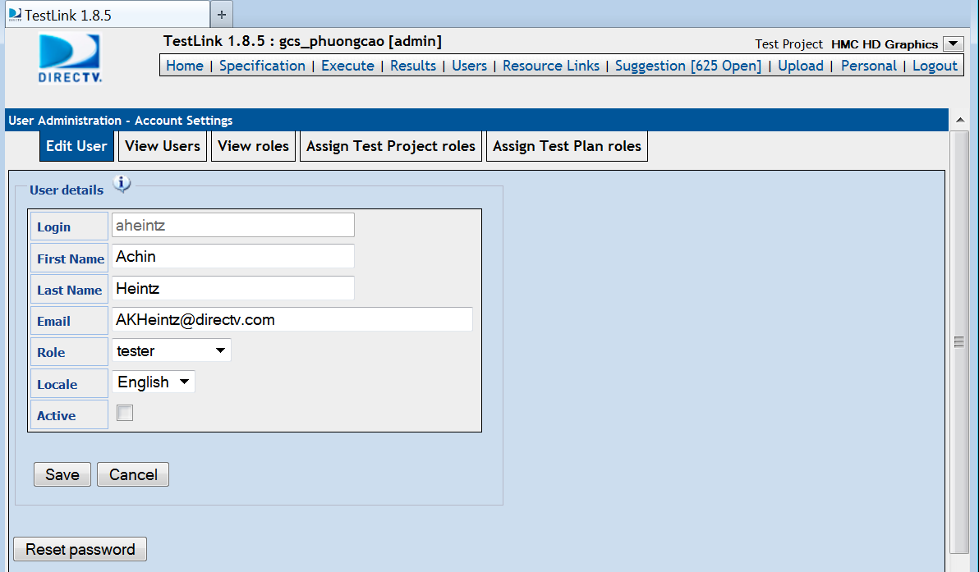
Manage user account – Remove user
To remove an existing user, you must turn the user into inactive mode, then click on the “Delete” ( ) button
Uncheck this to turn the user to inactive mode

Slide 7
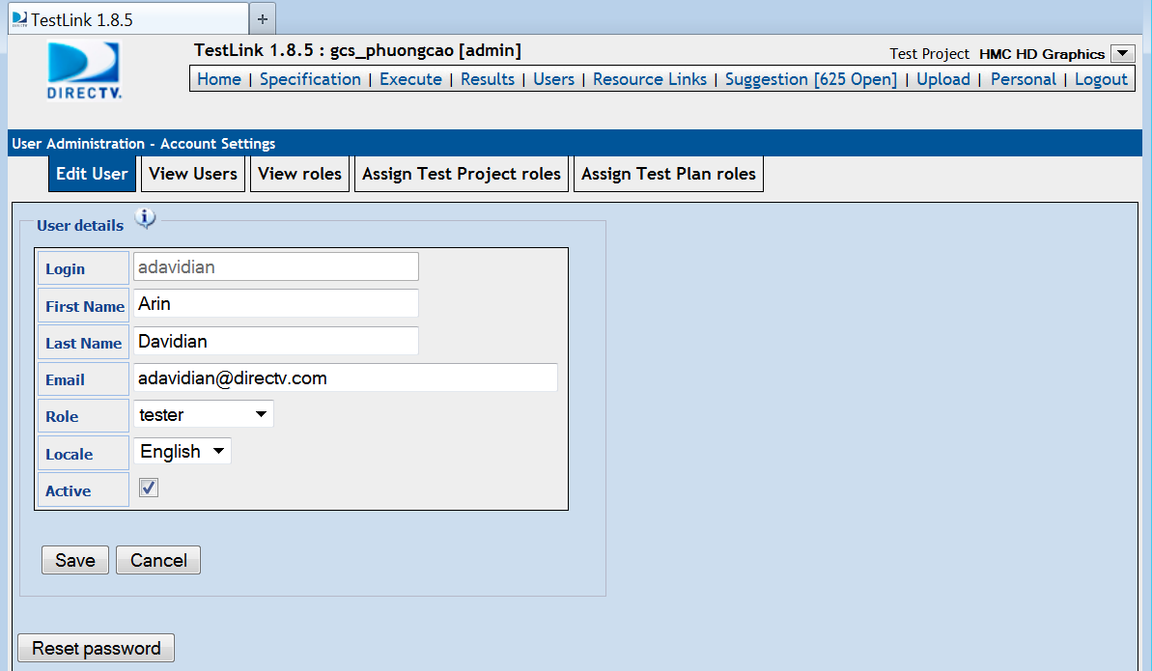
Manage user account – Edit user
To edit a user information, select “View Users” tab, click on the “Login” name of the user you want to edit information.
You can edit First Name, Last Name, email, role, Locale and reset password.

Slide 8
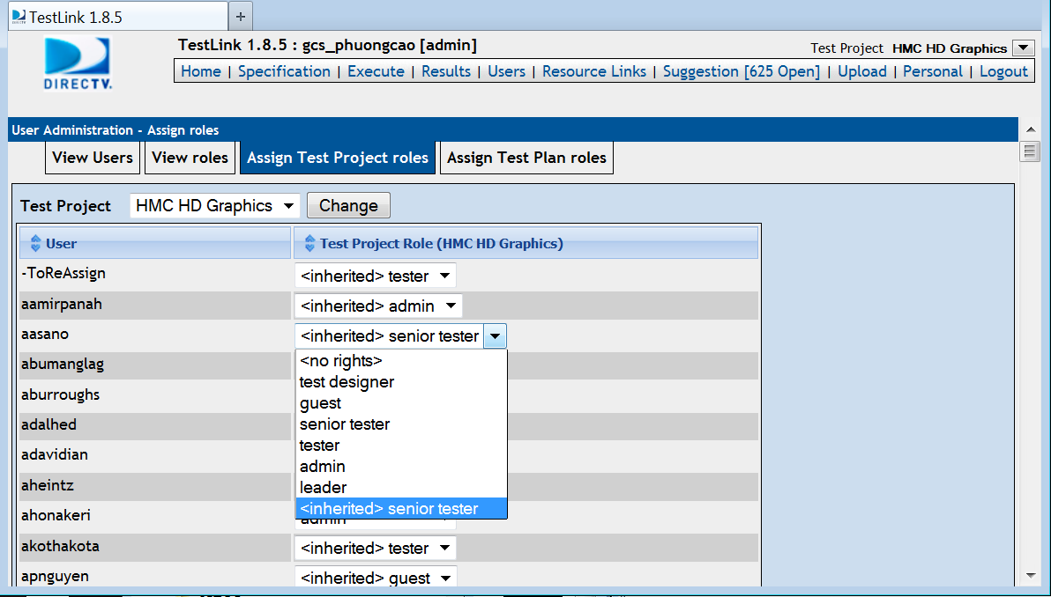
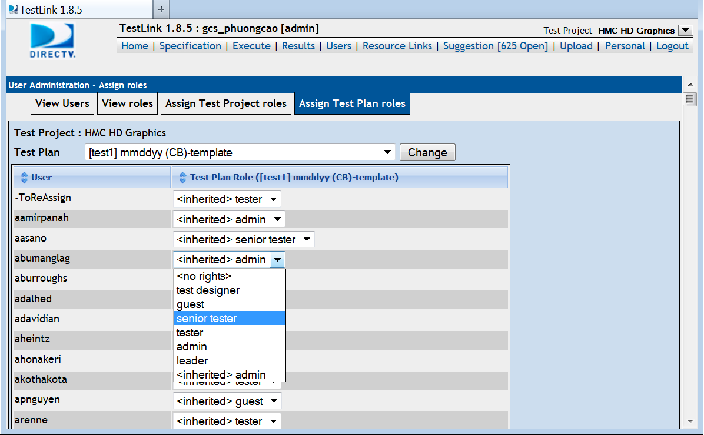
Manage user account – Assign roles for a user
User with different roles has different privileges.
Administrators, the users having role admin, can assign Test Project roles or Test Plan roles to other users. When a user is assigned a role on Test Project, he will have that same role in all of the Test Plan belong to that Test Project. If a user is only assigned a role to a Test Plan, he only has that role for that Test Plan.

Slide 9
What Administrators need to know?
How to manage user account (add/remove users, assign role to users on Test Project or Test Plan)
How to manage test project, test plan, compare test plan.
How to view history of test creation for individual test cases.

Slide 10
Manage Test Project
Administrators can add/remove Test Project and modify an existing Test Project.
To manage the “Test Project” select “Test Project Management” link at Home page

Slide 11
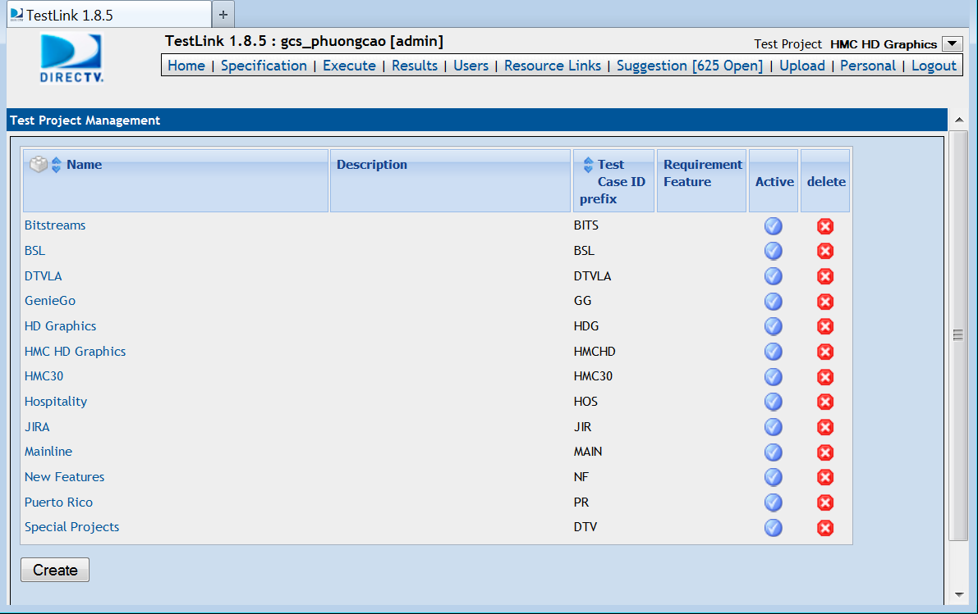
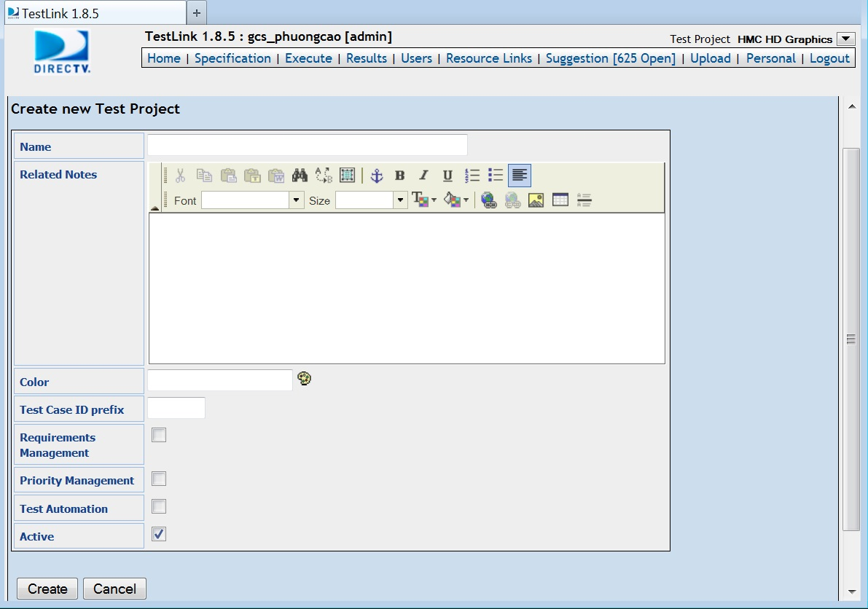
Manage Test Project – Add Test Project
To add new Project, select “Create” button on the Test Project Management page.
The name of the project and the Test Case ID prefix must be filled in.
Requirements Management, Priority Management, Test Automation checkboxes are optional and should be checked if the project relates to these.
Active box is checked as default.

Slide 12
Manage Test Project – Remove Test Project
To remove an existing Test Project, click on the delete ( ) button on the line of that Project. This will turn the Project into Inactive mode.

Slide 13
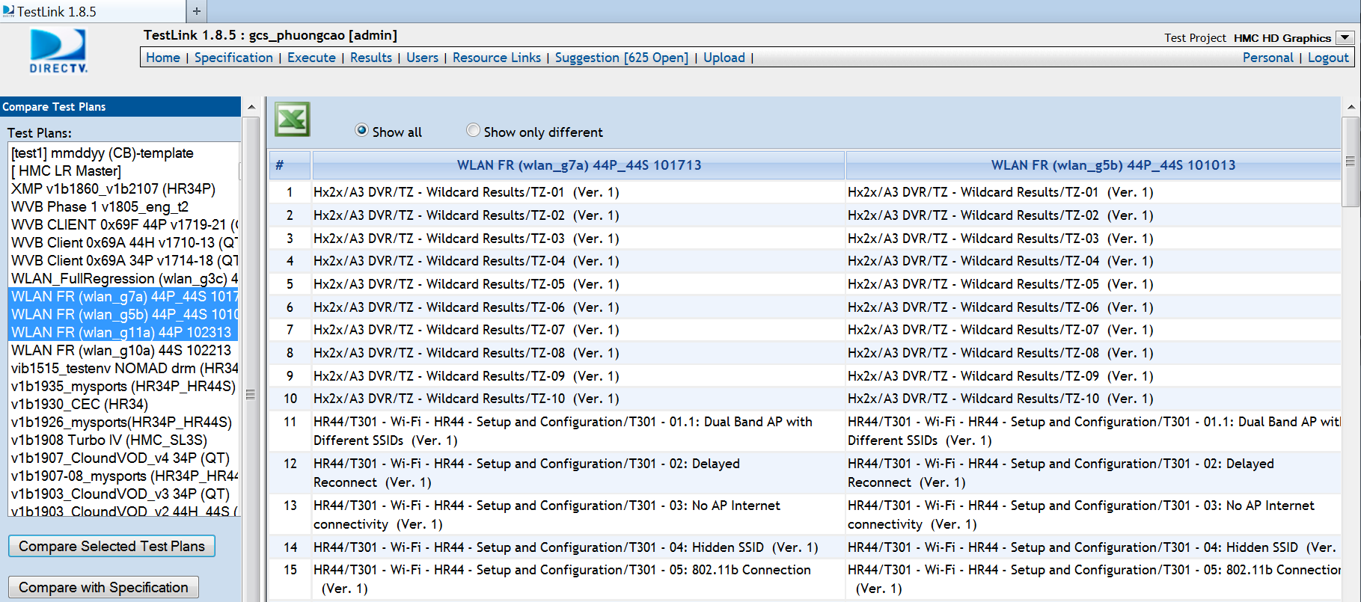
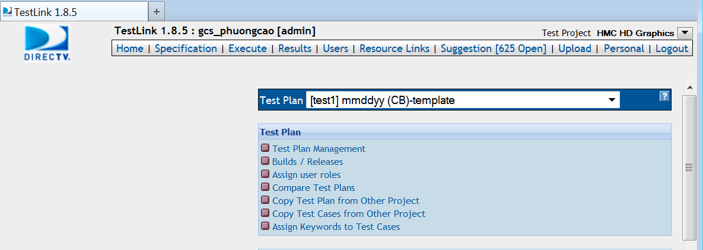
Manage Test Project – Compare Test Plans
To compare Test Plans select “Compare Test Plans” link, then select the Test Plans you want to compare.

Slide 14
What Administrators need to know?
How to manage user account (add/remove users, assign role to users on Test Project or Test Plan)
How to manage test project, test plan, compare test plan.
How to track versions of test cases.

Slide 15
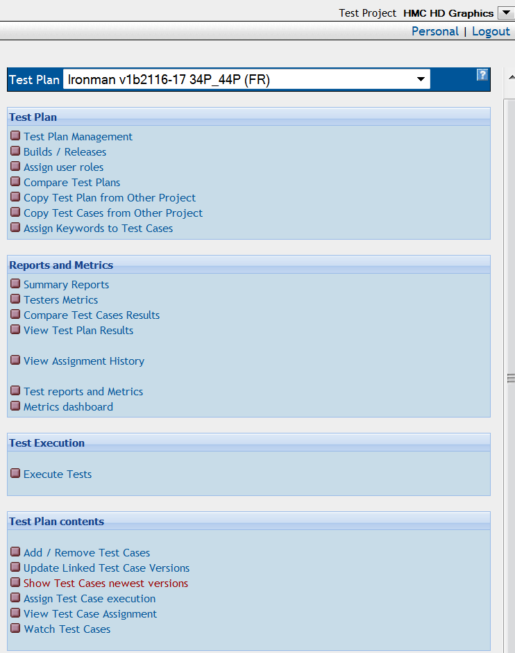
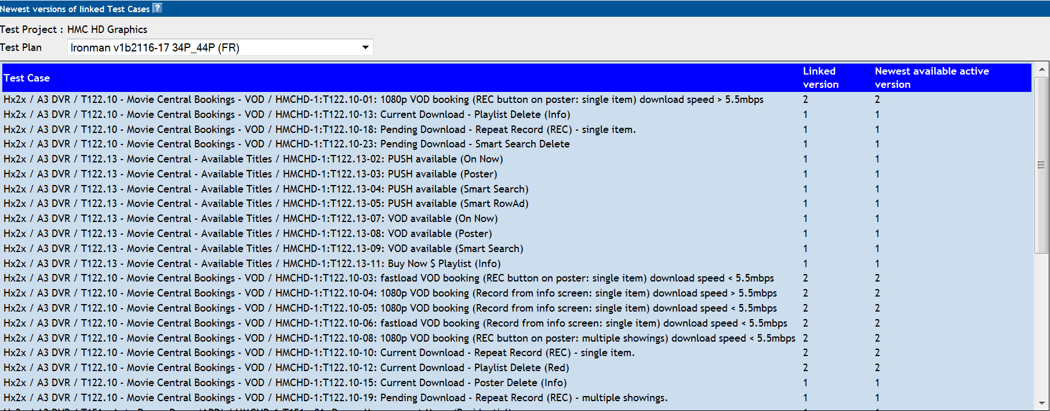
Test case newest version
To check if the version of all test cases in a Test Plan are the newest, you must select the Test Plan, then click on “Show Test Cases newest versions”.

Slide 16
Thank you

